Slide 1
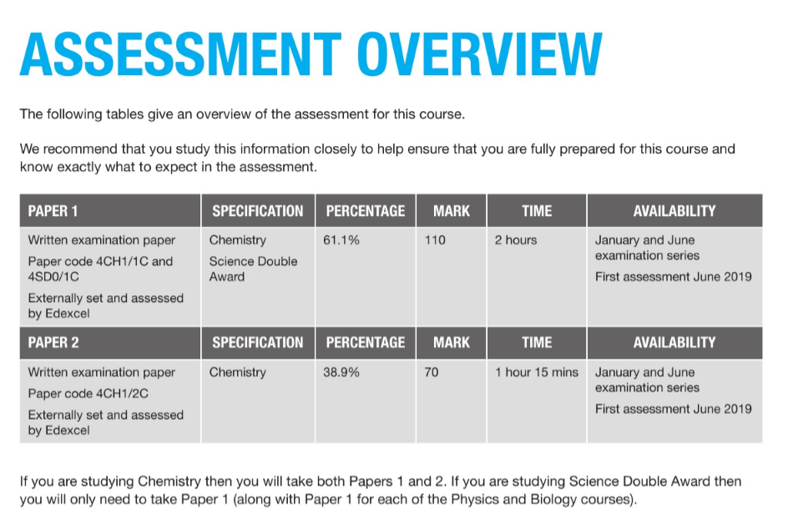
International GCSE chemistry (Edexcel guideline)

Slide 2
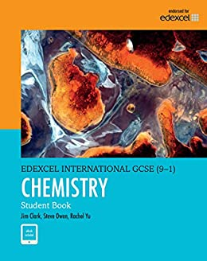
Chemistry edexcel international GCSE

Slide 3
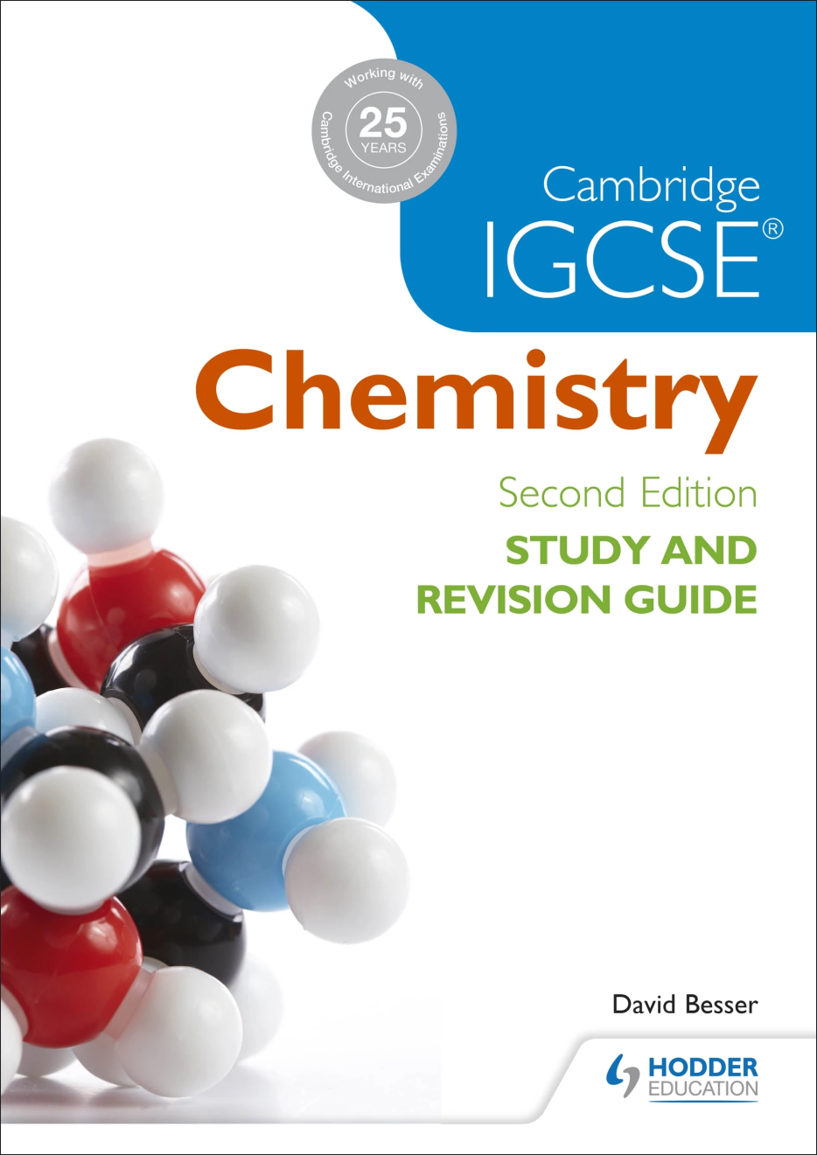
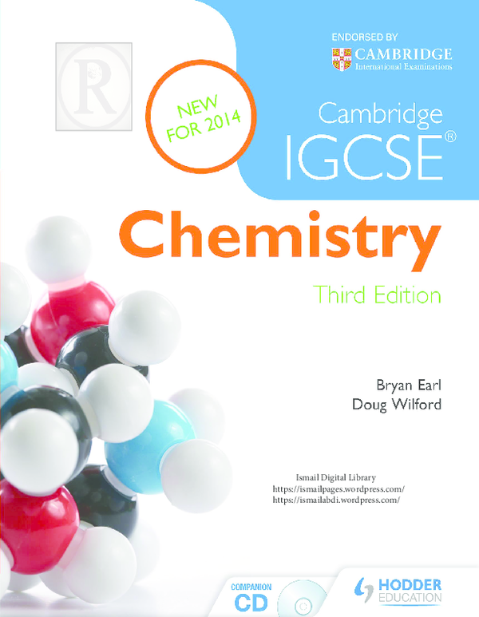

Slide 4
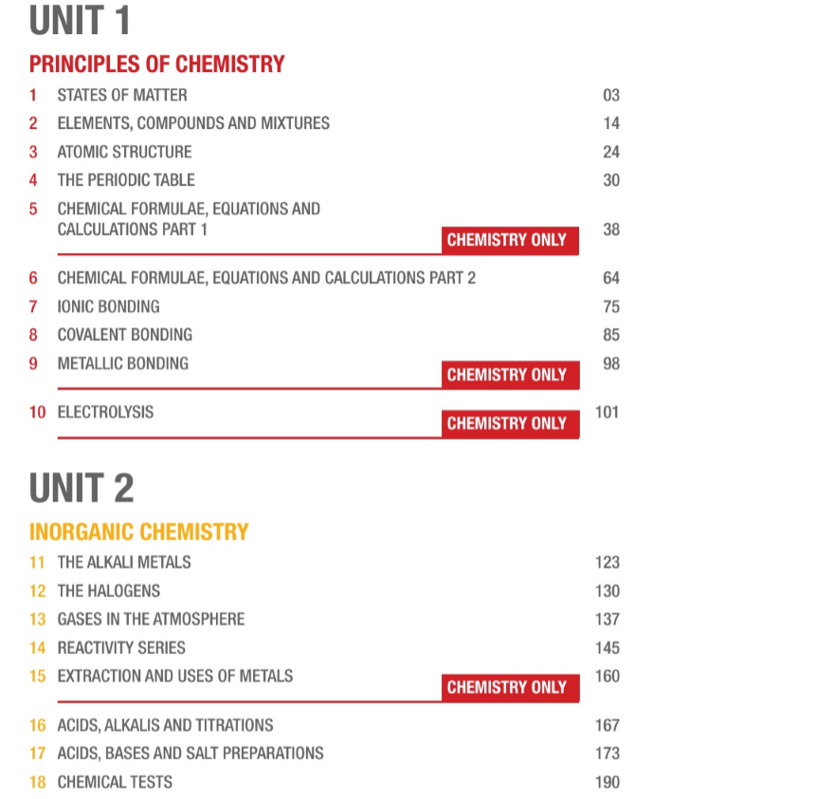
Contents you have to study

Slide 5
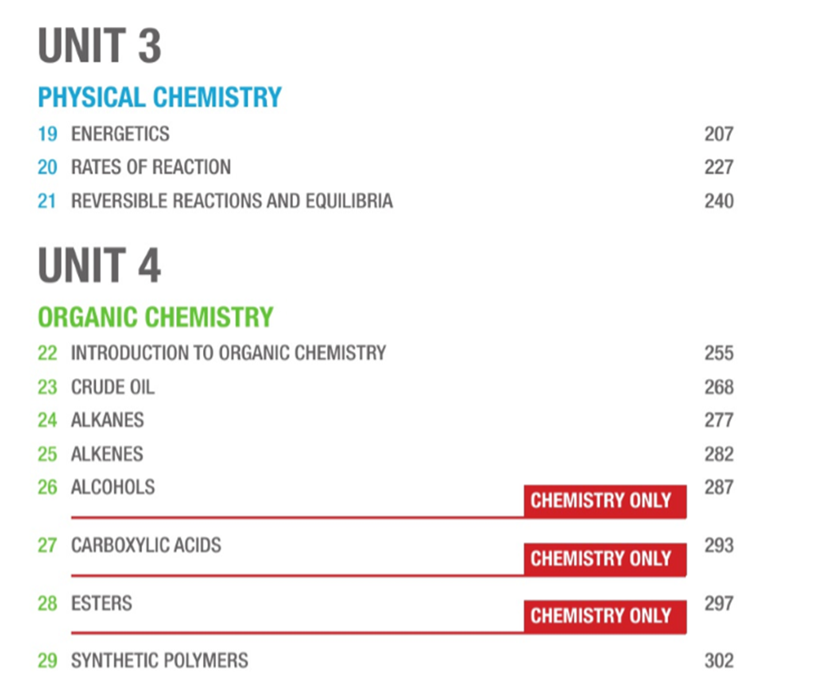

Slide 6


Introduction to chemistry
Matter?
Anything that has mass and volume.
e.g. solid books,cake,wood.
liquid water ,juice, oil.
gas air,smoke .
Examples of non-matter
Different types of energy , emotion and feelings.

Slide 7
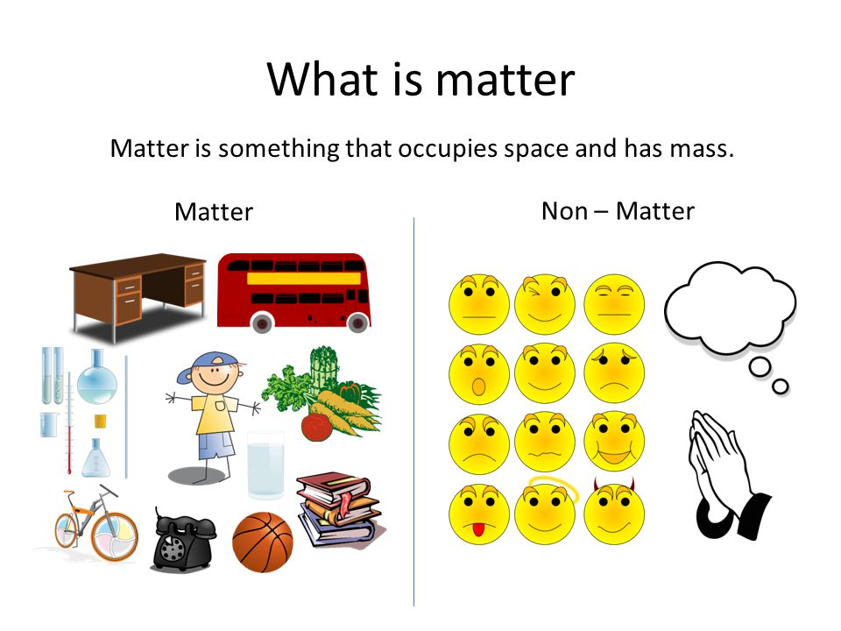

Slide 8
Matter
matter
Pure substances
Impure substances
Element
compound
mixture

Slide 9
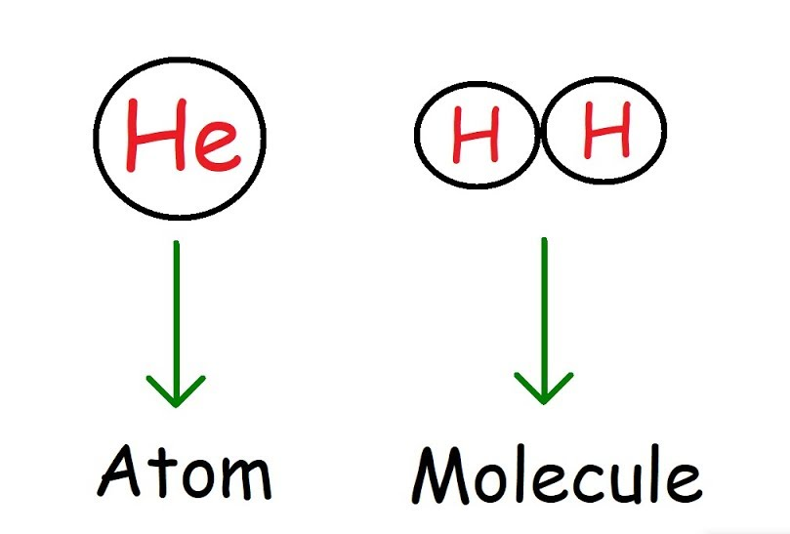
Elements
An element is a substance that can not be broken down into simpler substances by chemical methods.
(or)
An element is made up of only one type of atom.
Two type of elements
1. Simple elements
They are made up of one type of element with one atom.
e.g. all metal (Fe,Mg,Na)
all nobel gas (He,Ne)
some non-metals (C,Si,B)

Slide 10
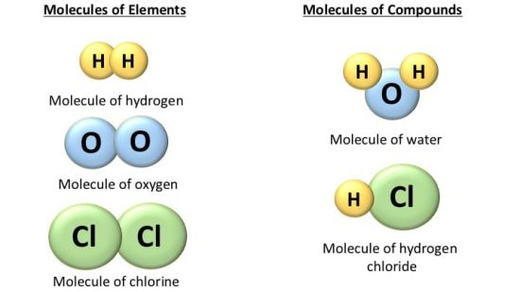
2. Molecules elements
They are made up of only one type of elements but with more than one atom.
e.g. some gases (02,H2,N2,Cl2,Br2,I2,O3)
Some non-metals (P4,S8)

Slide 11
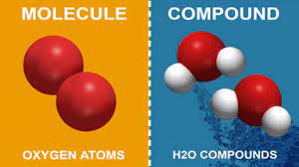
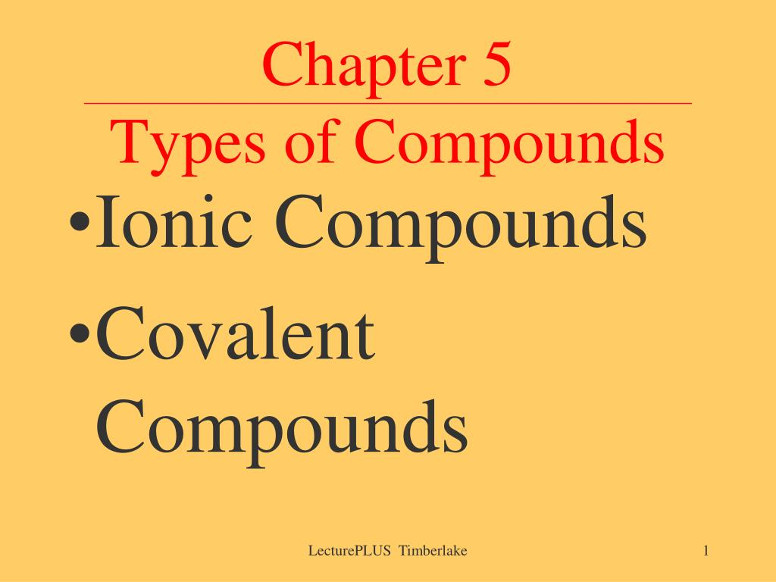
Compounds
Two or more different elements are chemically bounded.

Slide 12

Mixture
Homogenous mixture completely mixed(form one layer)
Eg, solid metal ore / metal alloy
liquid ocean water
gas atmospheric air
Heterogenous mixture incompletely mixed(form more than one layer)
e.g.solid salt and sand / lime stone and carbon powder
liquid oil and water
gas dust and air
Two or more different substances (element or compound) are mixed together that can be seperated by physical methods.

Slide 13
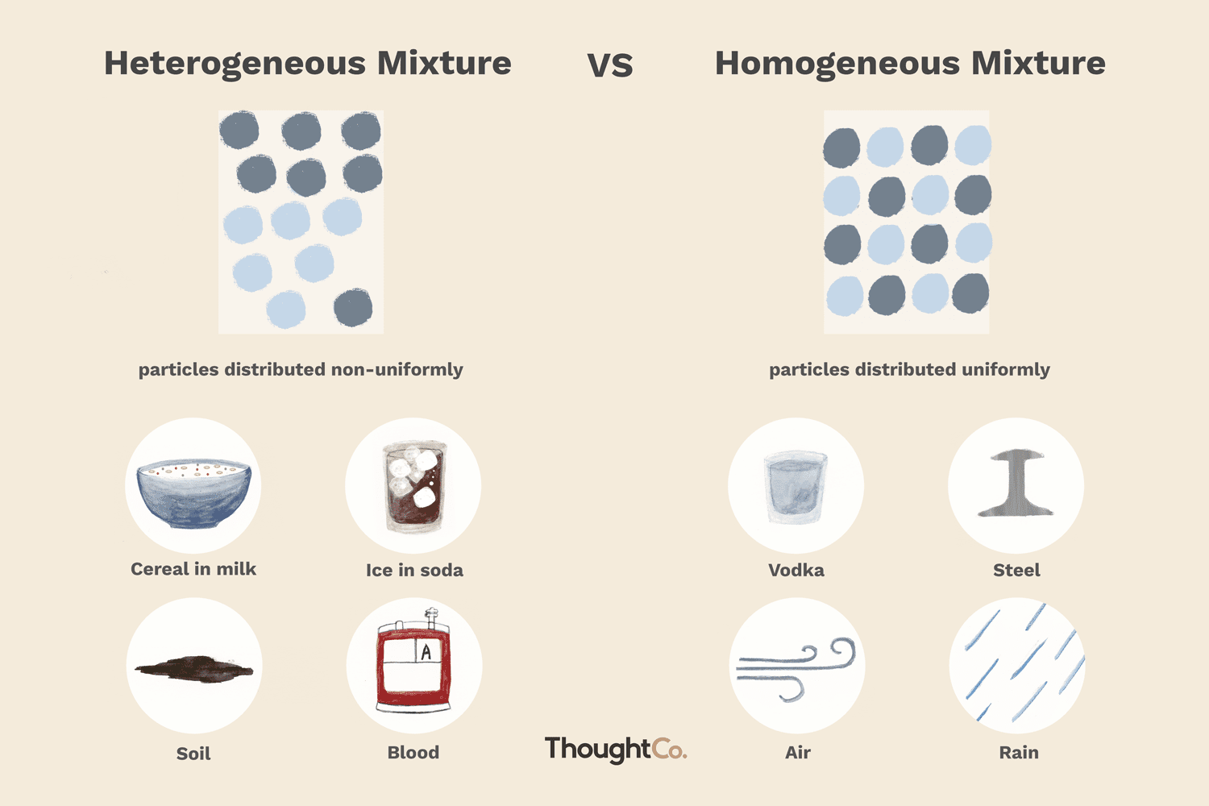

Slide 14
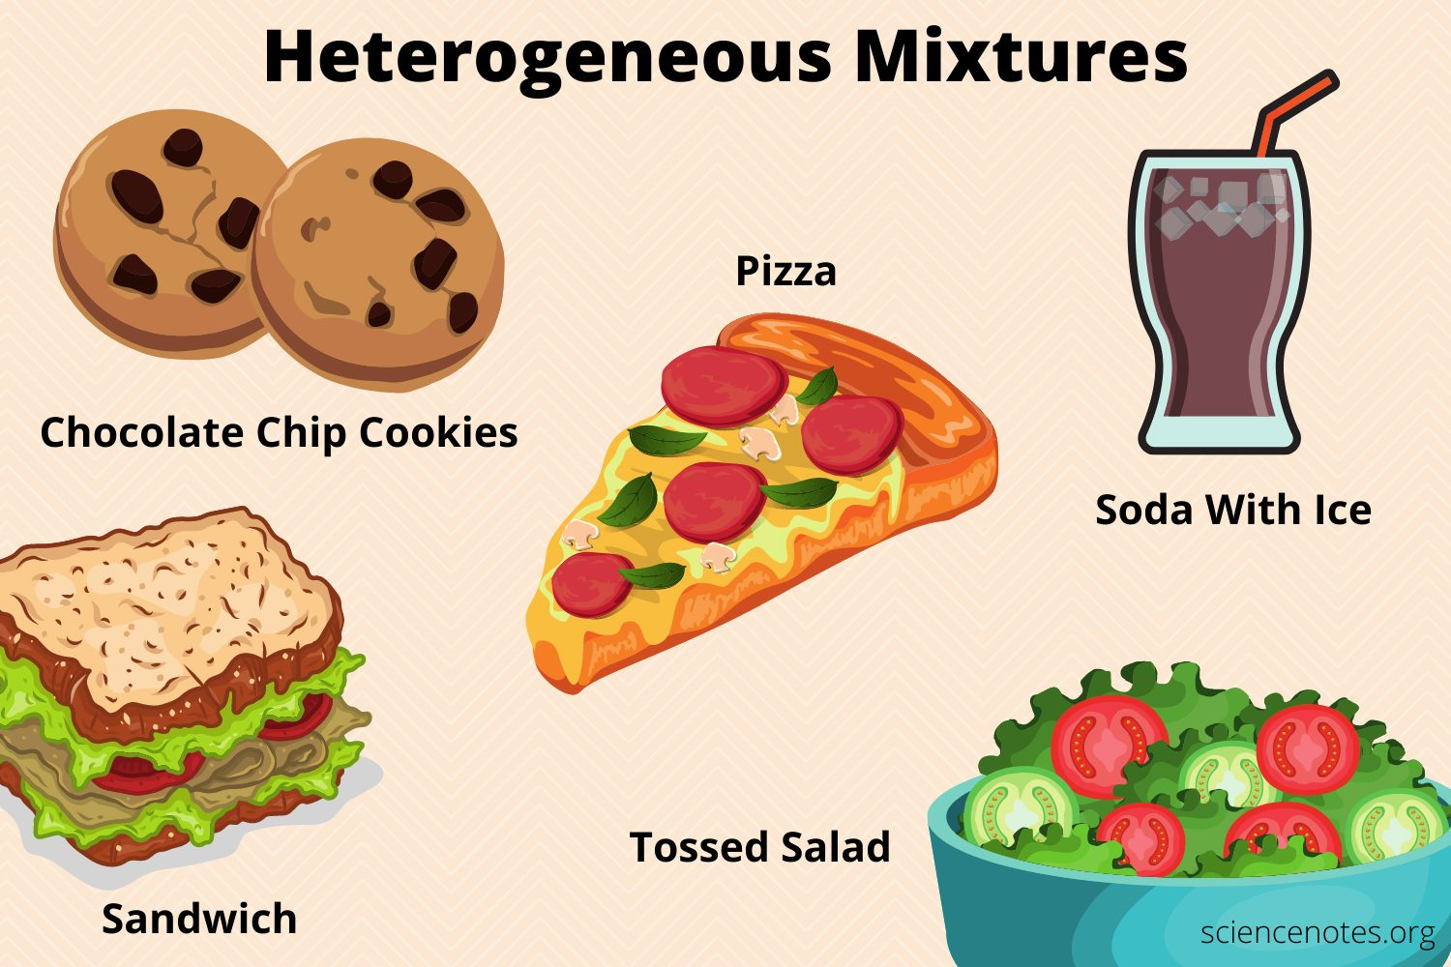

Slide 15
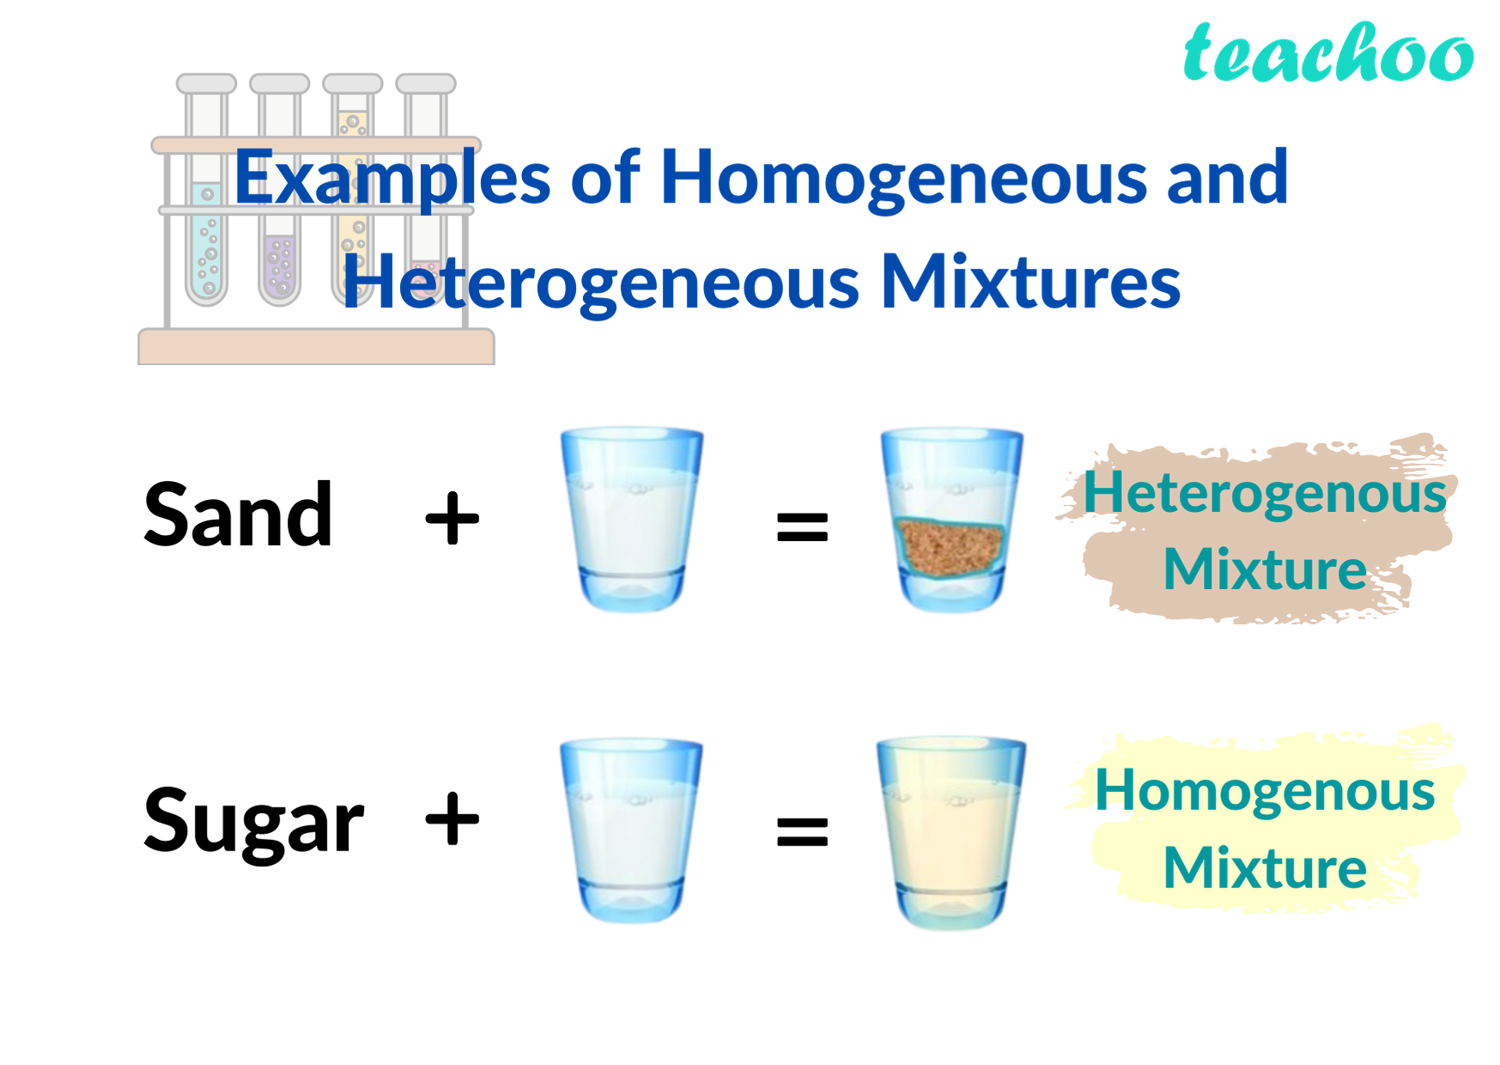

Slide 16
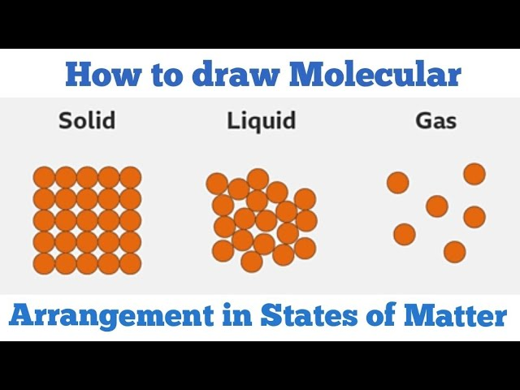
Properties | Solid | Liquid | Gas
Diagrams
Particles Seperation | Closely packed | Just touched | Far apart
Arrangement | Regular | Irregular | Random (much space)
Force of attraction | Very strong | Strong | Weak/absent
Shape | Fixed | Not Fixed (take the container shape) | Not Fixed (take the container shape )
Volume | Fixed | Fixed | Not fixed
Compressibility | No | No | Yes
Movement | Can’t move Just vibrate at fixed point | Can move Slide past over each other | Can move freely Randomly/all direction
Density | high | low | Very low
Kinetic energy | Very low | High | Very high

Slide 17
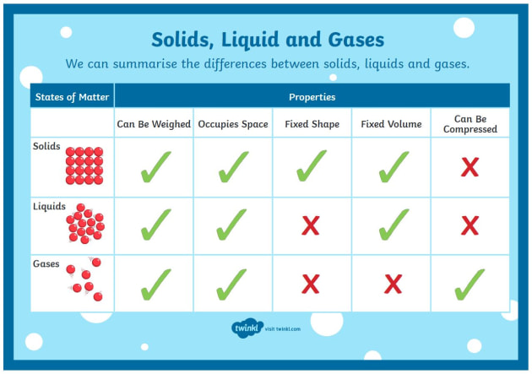

Slide 18
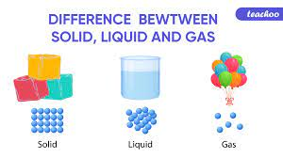

Slide 19
Q. Explain how a solid is changed into a liquid during melting (heating) in terms of kinetic particle theory.
On heating, solid particles gain more heat energy and so vibrate faster.
with enough vibration, some force of attraction between particles are broken and solid is changed into the liquid.
Q. Explain how a liquid is changed into a solid during freezing (cooling) in terms of kinetic particle theory.
On cooling, liquid particles lose heat energy and so move slower.
The force of attraction between particles becomes stronger and makes new forces.
So, the liquid is changed into a solid.

Slide 20
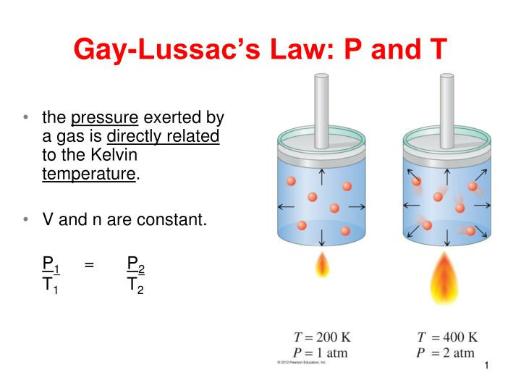
gas laws
Guy-lussac law
(Relation between temperature and pressure of gas)
When a gas is heated in a closed container, the gas particles gain heat energy and they move ………, So, they hit on the inner wall of container more often with ………..……. force causing ………..……. pressure. The ……….….. the temperature, the …………. the pressure will be in the closed container. They are ………………………………….. each other.

Slide 21
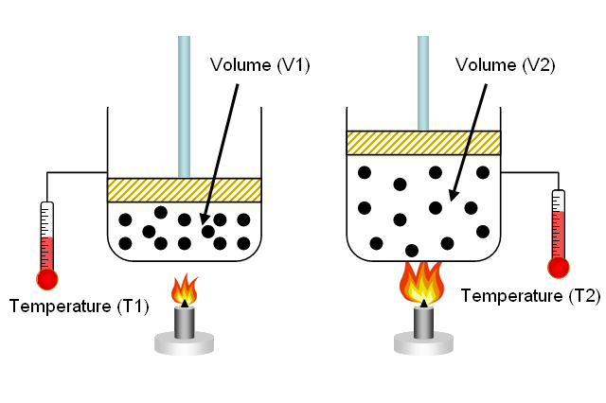
Charles’ law
(Relation between temperature and volume of gas )
When a gas is heated in a closed container, the gas particles gain…….and they …….. So, they push on the syringe plunger with greater force causing greater volume. The ..….. the temperature, the ……..the volume of gas will be in the gas syringe. They are ……proportional to each other.

Slide 22
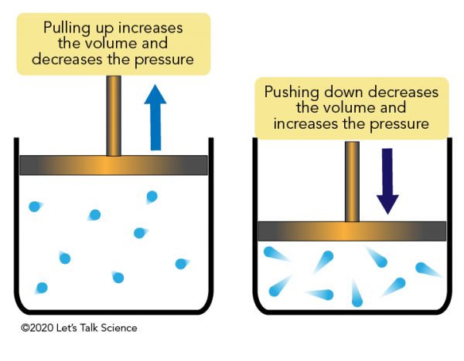
Boyle’s law
(Relation between pressure and volume)
When a gas is ……. in a gas syringe, the gas particles are …… and they form …… volume. The …… the pressure , the ……. the volume of gas will be in the gas syringe. They are inversely proportional each other.

Slide 23
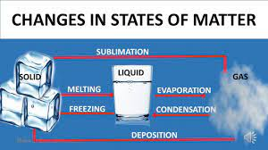

Slide 24
Process Change in state Energy
1. Melting
2. Boiling
3. Condensation
4. Freezing
5. Sublimation
6. Deposition

Slide 25
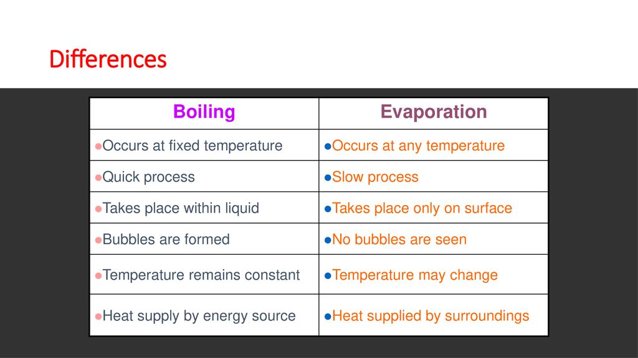

Slide 26
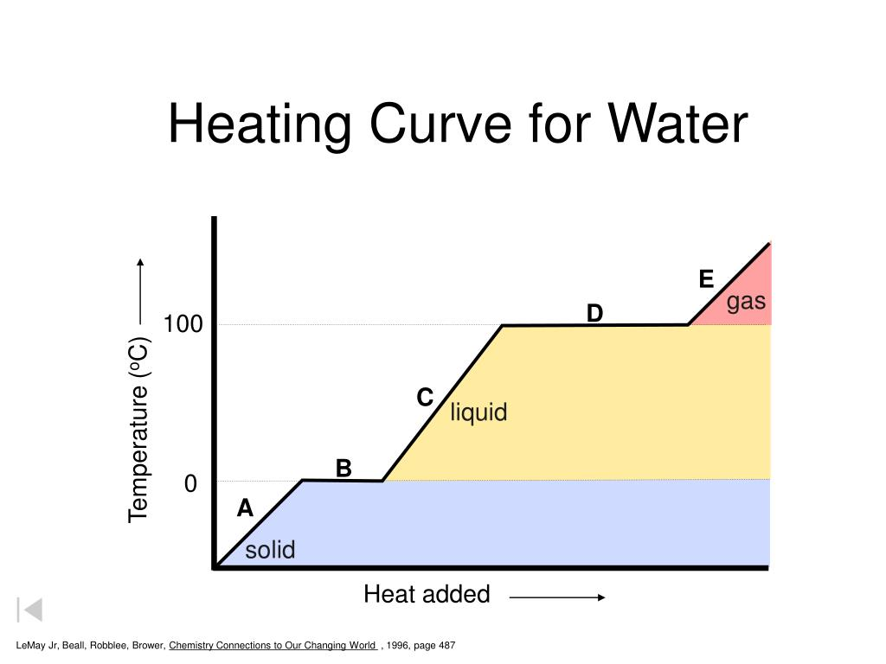

Slide 27
Heating curve of water
• In a solid the particles are held in position by bonding to their neighbours. (……. on the graph).
• As the solid is warmed the particles vibrate but cannot move. (…… on the graph)
• At the melting point heat needs to be added to melt the solid and break some bonds between the particles, so the temperature doesn’t rise until it is all liquid. (………. on the graph)
• At the boiling point heat needs to be added to change break all the forces between the particles in the liquid turning the substance into a gas. (………..on the graph)

Slide 28
Q. Explain why melting point of any substance is always lower than its boiling point.
Only some forces of attraction between solid particles are broken down in the melting.
But, all forces of atttraction between liquid particles are completely broken down in the boiling.
Q. Explain why temperature remains constant during melting and boiling.
In melting, the heat energy is absorberd by the solid and used to break down some forces of attraction between solid particles.
In boiling,the heat energy is absorbed by liquid and used to break down all forces of attraction between liquid particles.

Slide 29
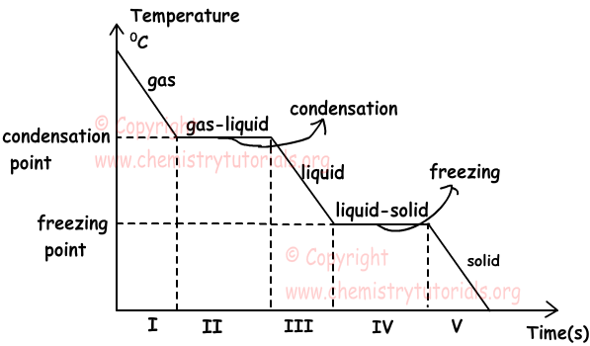
Cooling curves

Slide 30

Q; Explain why temperature remains constant during condensation and freezing.
In condensation, heat energy is released to make some forces of attraction between gas particles to form liquid.
In freezing, heat energy is released to make all forces of attraction between liquid particles to form solid.
Q:Determining the physical state of a substance at a given temperature using melting and boiling point.
Solid given temperature < melting point
Liquid melting point < given temperature < boiling point
Gas given temperature > boiling point

Slide 31
Substance | Melting point/’C | Boiling point/’C | At Room T | At 300’C
A | 1500 | 3000
B | -104 | -60
C | -210 | 102
D | 70 | 350
E | -60 | 26
F | 20 | 500
G | 405 | 706
H | -20 | -20

Slide 32
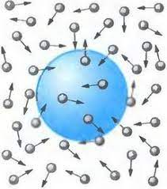
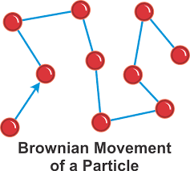
Kinetics particles theory
Brownian motion is the random, irregular bombardment of visible particles, by particles of water or air in all directions.
Evidence of Brownian motion includes:
1. The random motion of tiny particles of graphite or toothpaste suspended in water.
2. The random motion of dust or smoke particles in the air.
3. The random movement of dead pollen grains in water.

Slide 33
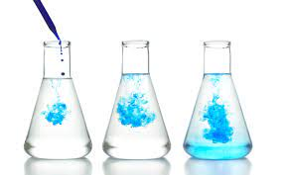
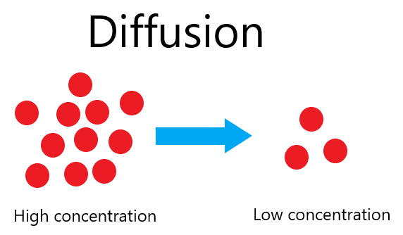
Diffusion
Diffusion is a random movement of different particles from a region of higher concentration to a region of lower concentration to fill the whole space available.
It can take place in ……………… and ………………..……..
Diffusion is the fastest in gases because the gas particles are very energetic and move at great speeds.
The speed of diffusion is affected by:
(a) Temperature: The higher the temperature, the faster the rate of diffusion. (At higher temperature, the particles gain heat energy and diffuse with faster speed.)
(b) Mass of particles; At a given temperature, the lighter particles diffues faster than the heavier particles.
(c) concentration of the reactants

Slide 34
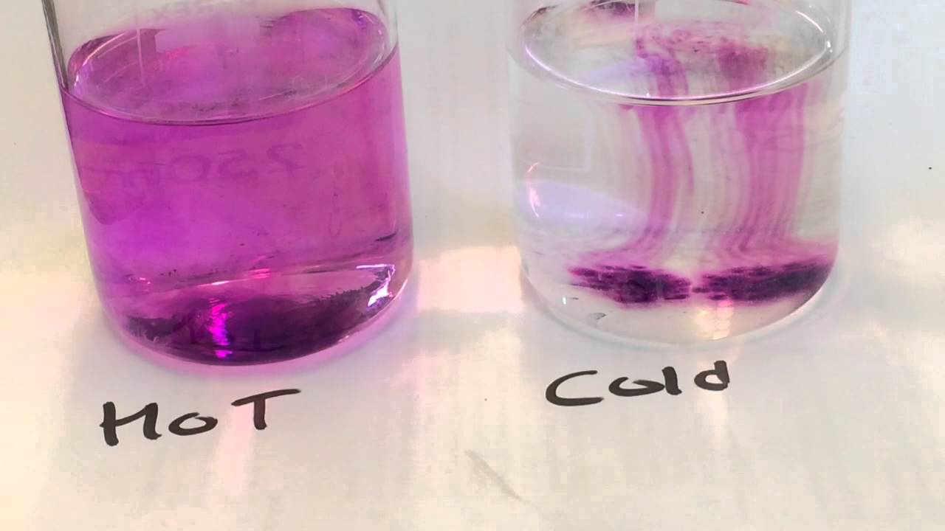
Diffusion of solid in liquid
Procedure; A small crystal of purple potassium manganate (VII) is dropped into a test tube of distilled water. After one week, the purple colour spread through the water to give a purple solution.
Explanation: The purple particles break away from the crystal when dissolved in water. The particles move out randomly in all directions to form uniform purple solutions.

Slide 35
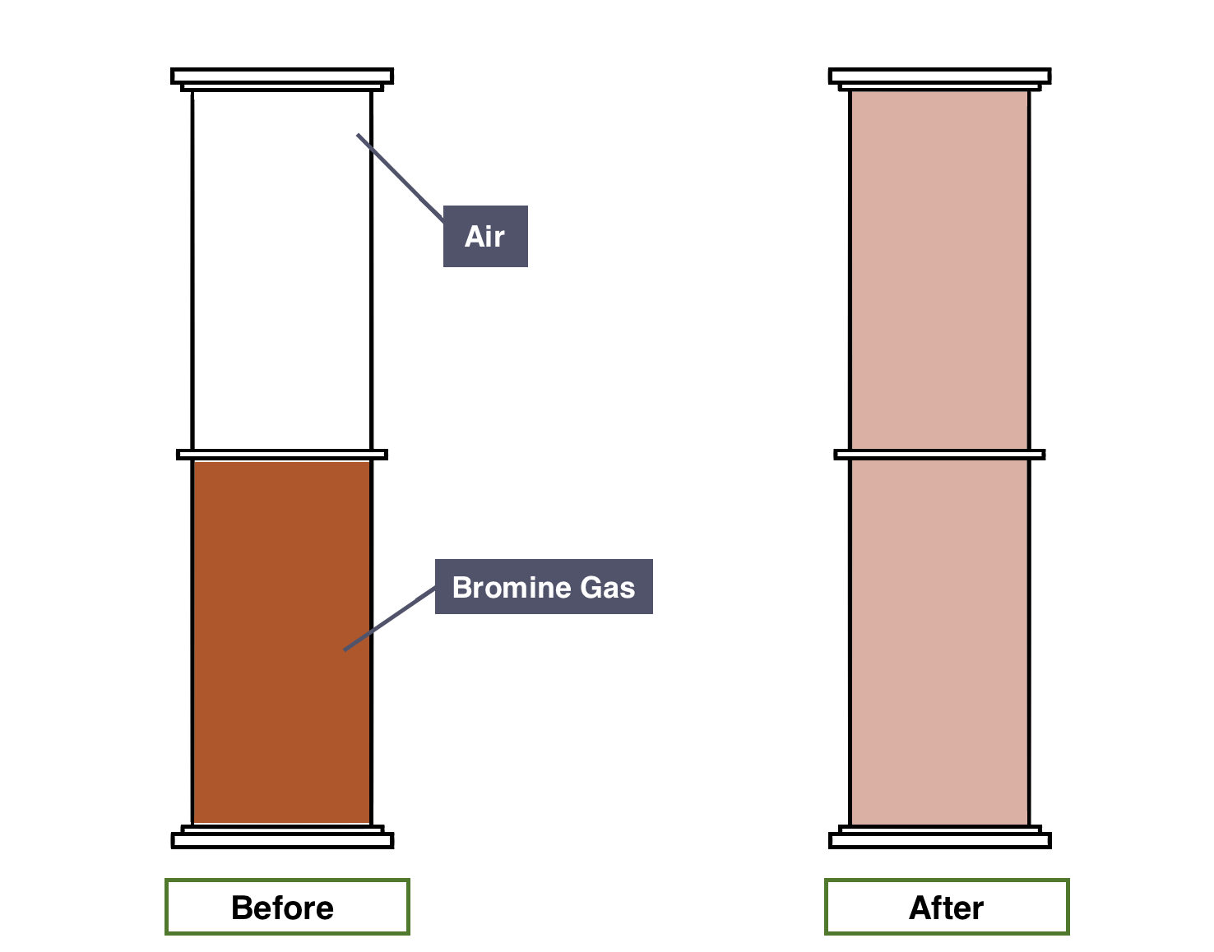
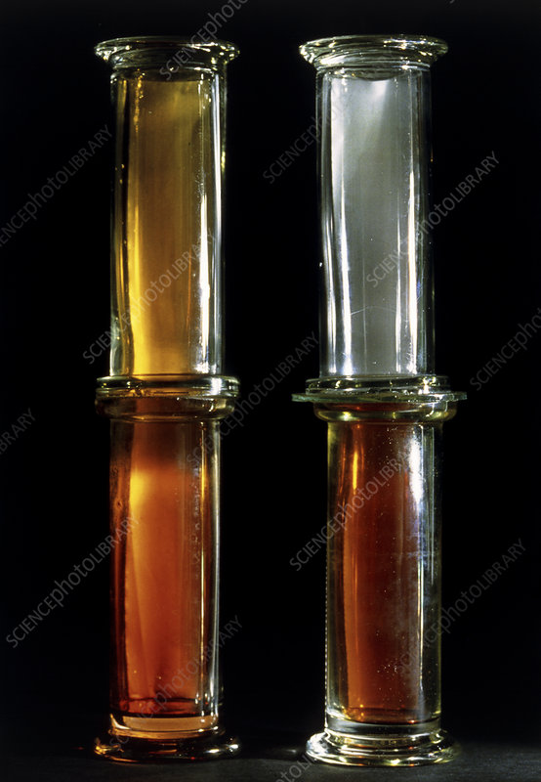
Diffusion of liquid in air
Procedure: 1-2 drops of liquid bromine are dropped into a gas jar. After a few hours, the gas jar is filled with a reddish brown vapour.
Explanation: The reddish brown liquid particles evaporate into reddish brown bromine gas. The gas particles move out randomly in all direction to all parts of the gas jar to produce a uniform brown vapour.

Slide 36
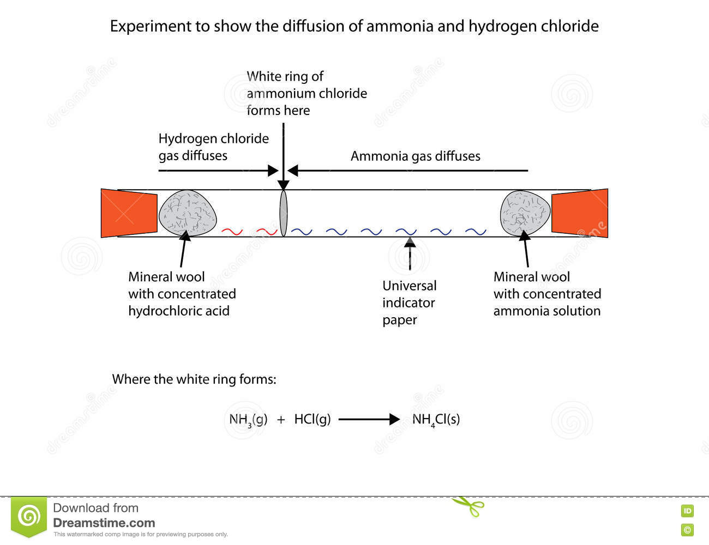
Diffusion of gases (Deposition or Neutralization)
Procedure:
A piece of cotton wool is soaked in concentrated hydrochloric acid. The acid gives off hydrogen chloride gas.
Another piece of cotton wool is soaked in concentrated ammonia solution. The base gives off ammonia gas.
Put cotton wools at opposite ends of a dry 100 cm long glass tube.

Slide 37

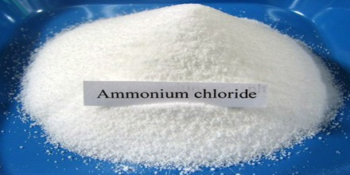
Observation:
After about five minutes,the white ring is formed near to the hydrochloric acid end of the tube.
Explanation:
Ammonia particles are lighter than hydrogen chloride particles. Ammonia particles diffuse faster and travelled further than hydrogen chloride particles. The white ring is ammonium chloride(NH4Cl).

Slide 38
Similarities and differences between brownian motion and diffusion
Similarities
Random movement of particles.
With the help of air or water molecules.
Differences
Brownain motion Diffusion
Visible particles small particles
(dust , smoke) (gas , air)
In all direction from higher concentration to lower one

Slide 39
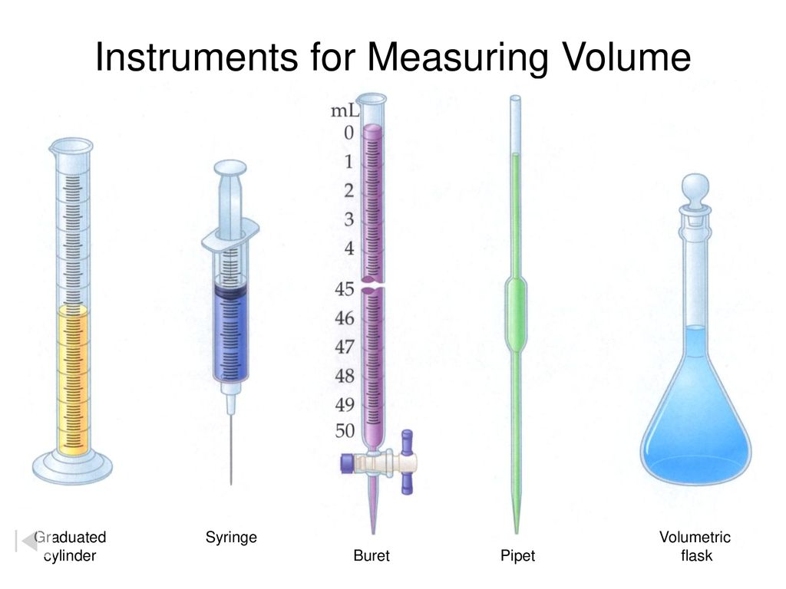
Measuring liquid volume

Slide 40
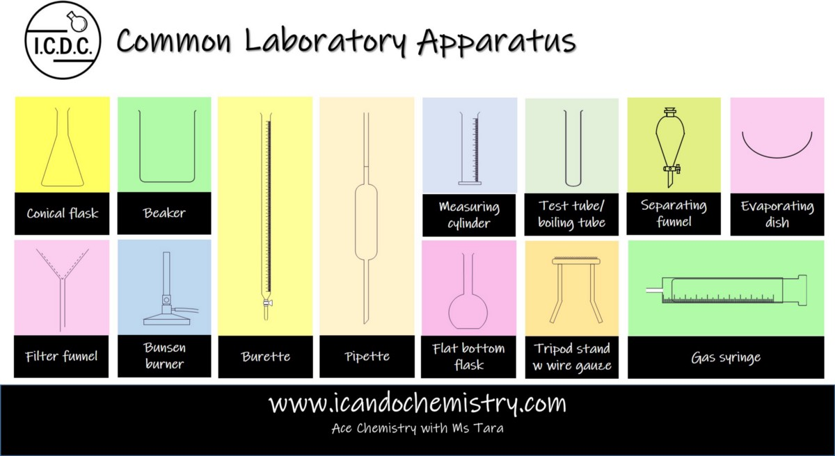

Slide 41
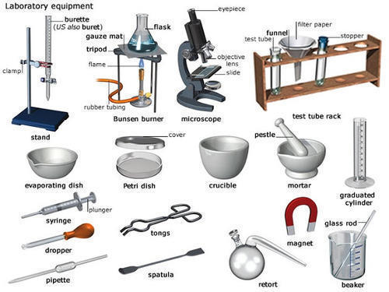

Slide 42
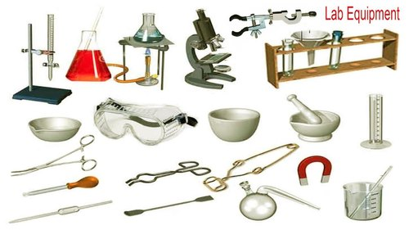

Slide 43
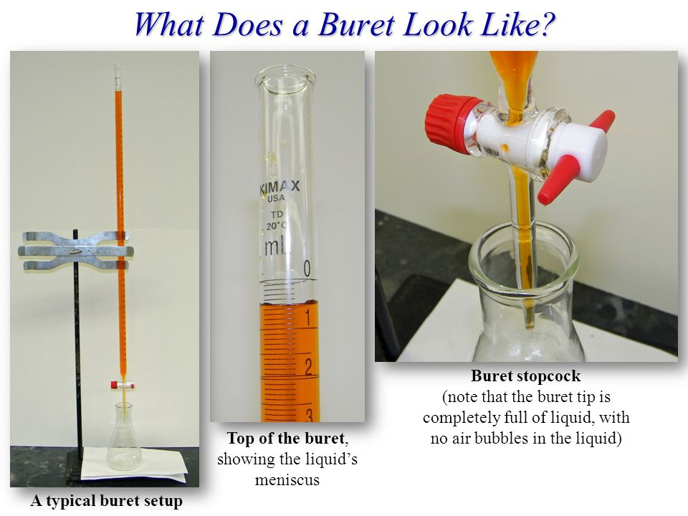

Slide 44
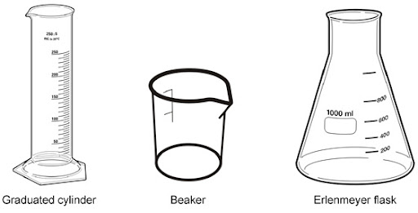
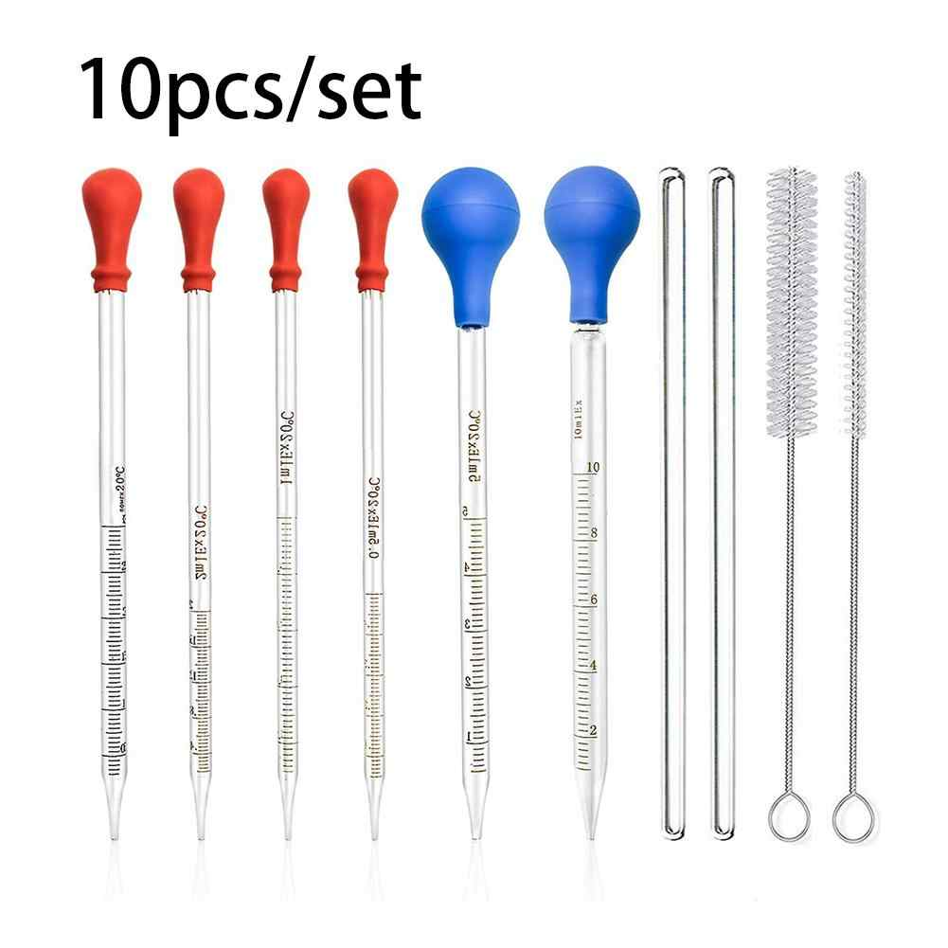
Measuring cylinder- >50cm3 or 50ml (not accurate but easy to use)
Burrette and pippette- <50cm3 or 50ml (accurate)

Slide 45
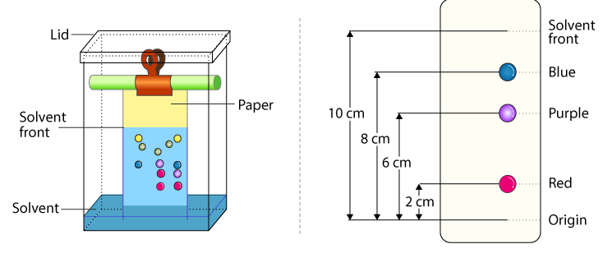
Paper chromatography
It is a very useful method for analysing and identifying mixtures of coloured substances (drugs, dyes in inks and food) or colourless substances (protein ,carbohydrate) using suitable solvent.
An example is to analyse and identify the dyes in a coloured ink.

Slide 46
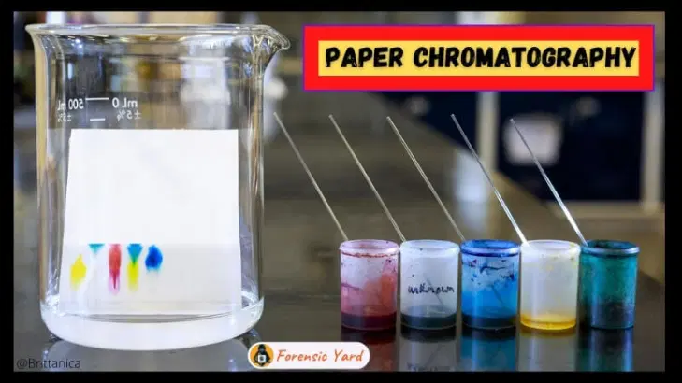
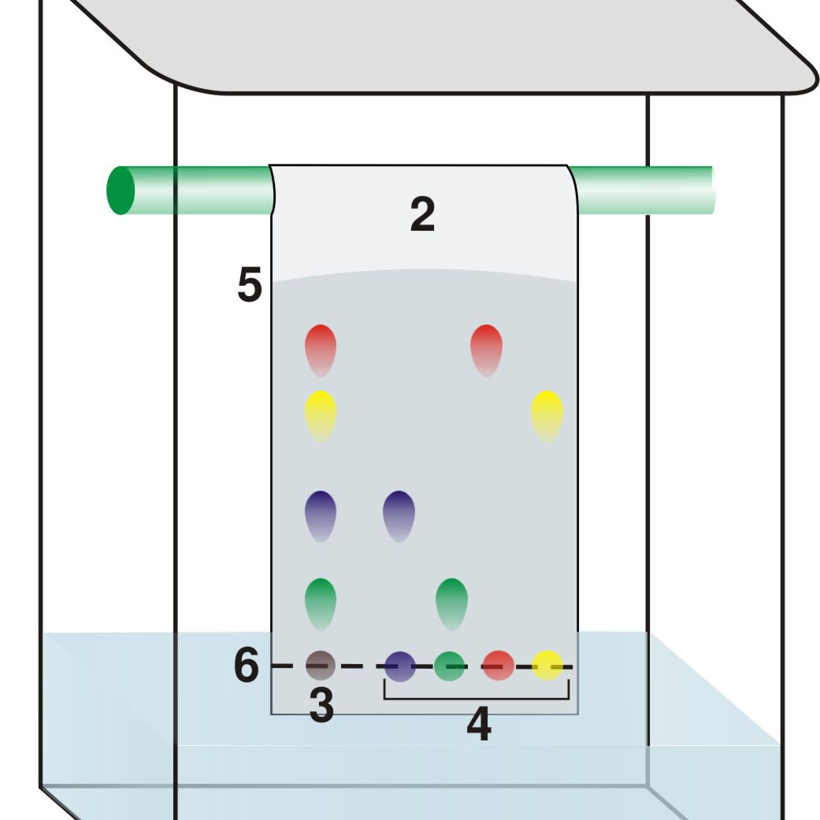

Slide 47
Procedure of chromatography
1. Choose a suitable solvent and chromatography paper.
2. Draw 2 lines at the ends of the paper with pencil(pencil is made up of graphite and is not soluble in solvent)
3. Drops of unknown and known dyes are placed on the start line of filter paper.
The paper is then suspended in a suitable solvent.
4. As the solvent moves up the paper(capillary action), the inks dissolve in the solvent and move up the paper at different speeds due to different solubilities and hence travel different distances.
The pattern of spots obtained is called a chromatogram.
For colourless substances, locating agents spray or UV light are used on the chromatogram to develop colour spots on the chromatogram.

Slide 48
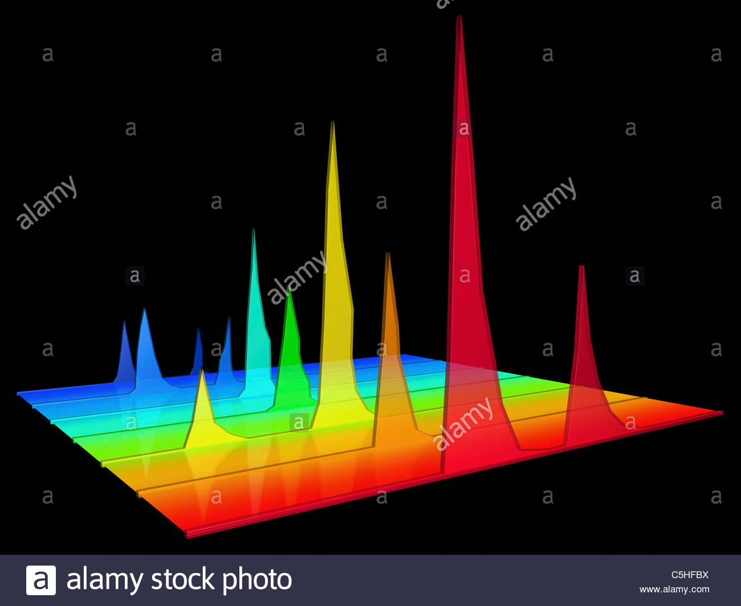
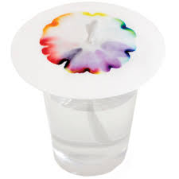
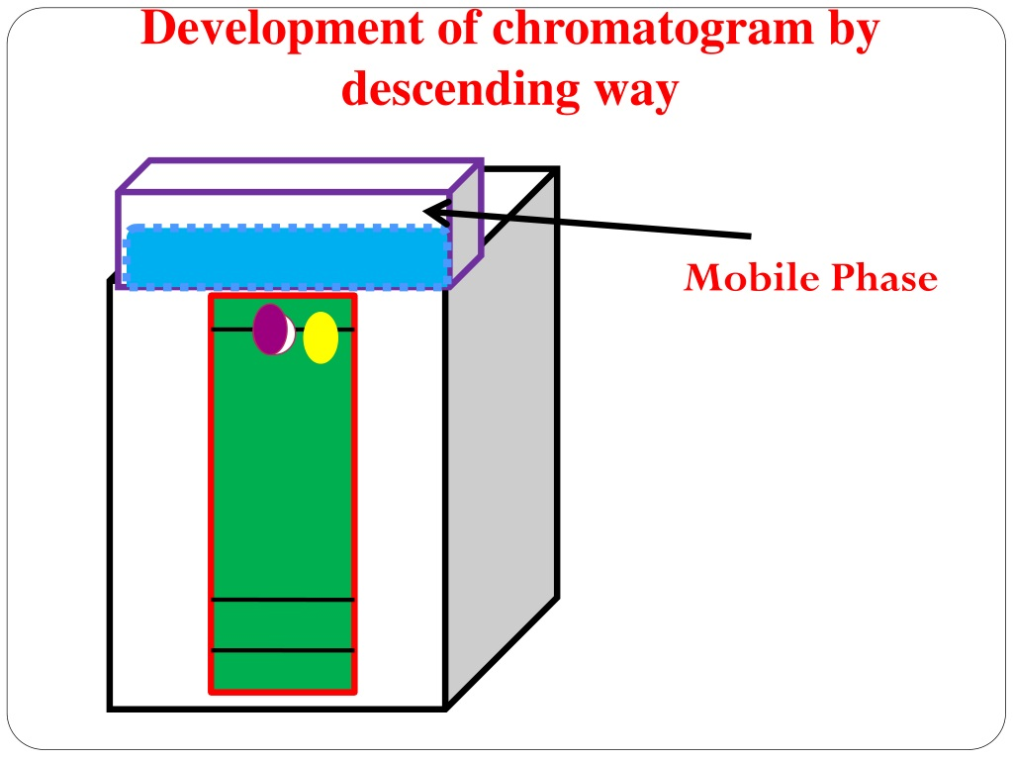
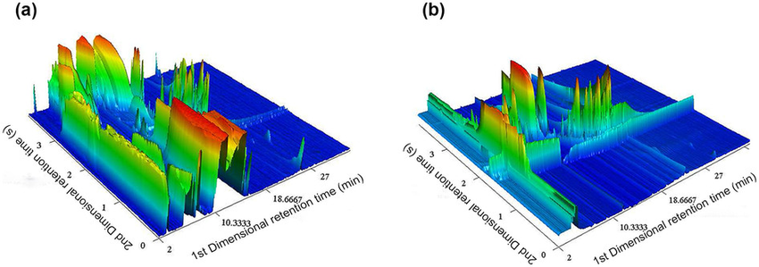
Types of chromatography
Ascending chromatography
Descending chromatography
Radial chromatography
3D chromatography

Slide 49
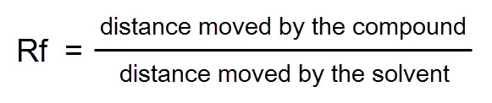
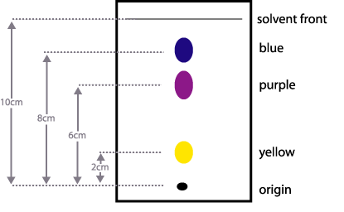
RF value (Retension/ retadation Factor value)

Slide 50
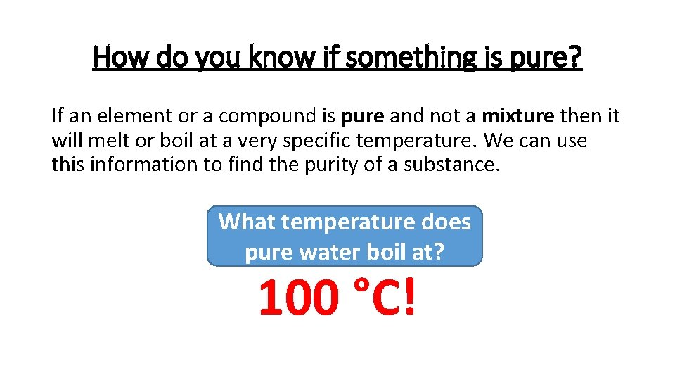

How can we know a pure compound?
On chromatography
Pure substance only one spot (fixed boiling and feezing)
Impure substance more than one spots (variable bpt and mpt)
mpt bpt

Slide 51
Common terms we have to know
Soluble - dissolve in water
Insoluble - not dissolve in water
Solute - solid substance
Solvent - liquid for dissolving solute
Solution - soluble solute + solvent
Suspension - insoluble solute + solvent
(solute are floating/ suspending in the liquid)
Miscible liquid - homogenous (form one layer)
Immisicible liquid - heterogenous(form 2 or more layers)

Slide 52


Slide 53



Method of putrification (physical methode)
Method | Mixture | Eg.
Decantation |  | Rising rice grains
Filtration |  | Sand/powder limestone & water
Centrifugation |  | Blood or urine test

Slide 54



Centrifugation

Slide 55



Methode | Mixture | Eg.
Evaporation |  | Soluble powder salt
Crystallisation |  | Soluble crystal salt
Recrystallisation |  | Purify the salt

Slide 56


Slide 57


Methode | Mixture | Eg.
Distillation |  | Pure water from sea water
Fractional distillation |  | Ethanol from fermented sugar solution Various fractions in crude oil
Separating funnel |  | Oil and water

Slide 58

Simple Distillation

Slide 59

Fractional distillation

Slide 60


Slide 61
Filtration
It separates the insoluble solids from suspension.
Eg. The seperation of salt and sand solution .
The salt and sand is dissolved in water and stir it.
The salt ( not sand ) dissolves in it.
Pour the solution into the filter paper and filter funnel.
The salt solution is passed through the paper as filtrate.
The sand is trapped on the paper as residuse.

Slide 62
Crystalliation(evaporation+crystallization)
It separates the soluble solid substances form a solution as a crystal salt. Eg. Copper 2 sulfate crystal preparation.
The salt solution is heated to boil off some solvant to be saturated.
The hot saturated solution is cooled at room temperature.
After some time, solid crystal appear.
Evaporation
It seperates the soluble solid substances from a solution as a powder salt.
Eg. Sodium chloride power manufacture from sea water.
The salt solution is heated to boil off all the solvant.

Slide 64





Slide 65


Sublimation
It seperates the mixture of solids in which one of them sublime.
(the process by which a solid is changed into a gas on heating without going into the liquid state).
Eg. Dry ice, ammonium chloride, moth ball , deodorant, iodine.
When the mixture of iodine and sand is heated, the iodine sublime to the gas state.
When they reach the cool area, they cool and crystallize as solid again.

Slide 66

Simple distillation
It separate a liquid from a solution by condensing vaporized liquid.(boiling + condensation process due to different bpt).
Solution is heated at 100’C to produce the stream which is then cooled in condenser jacket to form pure water distillate.
For smoother boiling ,boiling chips are added into the flask.
Water is fed at the lower end to fullfill the condenser all the time.

Slide 67


Slide 68



Slide 69

solubility
The solubility of a solid in a solvent at given temperature is the mass of solutes which dissolves in 100g of solvent to form a saturated solution.
Eg. The solubility of common salt (NaCl) in 100g water at 25’C is 36g.
(solubility of NaCl = 36 g per 100 g water).

Slide 70


Slide 71


Slide 72


Slide 73


Slide 74
Solubility experiments
( Edexcel text page 9 – activity 1 )

Slide 75




Slide 76

20g of water dissolves 12.28 g of solutes(KNO3) .
100g of water = 12.28 = 61.4 g of KNO3
Therefore, the solubility of KNO3 = 61.4 g per 100 g of solvent
100
20
Solubility formula
Solubility of KNO3 = 12.28g 100
20g
= 61.4 g of KNO3 in 100g water

Slide 77


Slide 78


Slide 79


Slide 80

Ends of chapter questions times
For
1.State of matter
2. element, compound & mxture

